Slide 1
VENN DIAGRAM

Slide 2
UNION
UNION:
  Let A and B be subsets of a universal set U. The union of sets A and B is the set of all elements in U that belongs to A or to B or to both, and is denoted A ∪ B.
  Symbolically:
  A ∪ B = {x ∈U | x ∈A or x ∈ B}
EMAMPLE:
  Let U = {a, b, c, d, e, f, g}
  A = {a, c, e, g}, B = {d, e, f, g}
  Then A ∪ B = {x ∈U | x ∈A or x ∈ B}
  ={a, c, d, e, f, g}

Slide 3
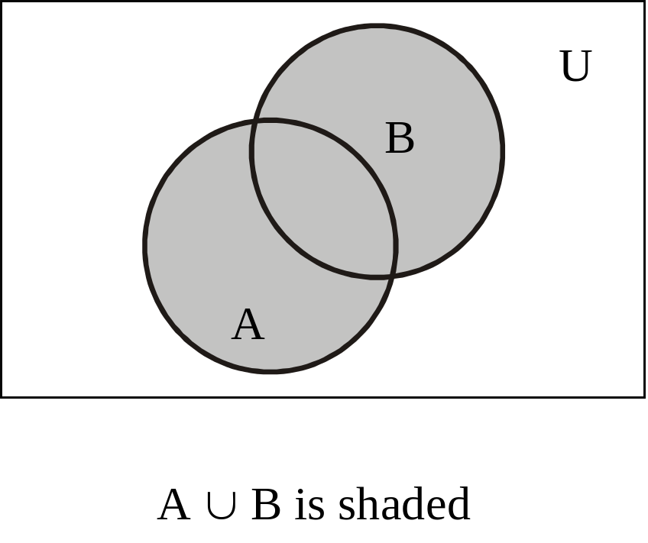
UNION
VENN DIAGRAM FOR UNION
REMARK
  1. A ∪ B = B ∪ A that is union is commutative you can prove this very easily only by using definition.
  2. A ⊆ A ∪ B and B ⊆ A ∪ B
  The above remark of subset is easily seen by the definition of union.

Slide 4
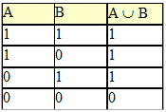
UNION
MEMBERSHIP TABLE FOR UNION
REMARK
  This membership table is similar to the truth table for logical connective, disjunction (∨).

Slide 5
INTERSECTION
Let A and B subsets of a universal set U. The intersection of sets A and B is the set of all elements in U that belong to both A and B and is denoted A ∩ B.
  Symbolically:
  A ∩ B = {x ∈U | x ∈ A and x ∈B}
EXMAPLE:
  Let U = {a, b, c, d, e, f, g}
  A = {a, c, e, g}, B = {d, e, f, g}
  Then A ∩ B = {e, g}

Slide 6
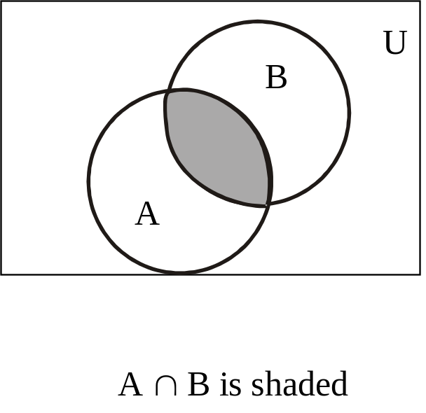
INTERSECTION
Venn Diagram for Intersection
REMARK:
  A ∩ B = B ∩ A
  A ∩ B ⊆ A and A ∩ B ⊆ B
  If A ∩ B = φ, then A & B are called disjoint sets.

Slide 7
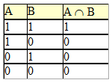
MEMBERSHIP TABLE FOR INTERSECTION
REMARK
  This membership table is similar to the truth table for logical connective, conjunction (∧).

Slide 8
DIFFERENCE
Let A and B be subsets of a universal set U. The difference of “A and B” (or relative complement of B in A) is the set of all elements in U that belong to A but not to B, and is denoted A – B or A \ B.
  Symbolically:
  A – B = {x ∈U | x ∈ A and x ∉ B}
EXAMPLE:
  Let U = {a, b, c, d, e, f, g}
  A = {a, c, e, g}, B = {d, e, f, g}
  Then A – B = {a, c}

Slide 9
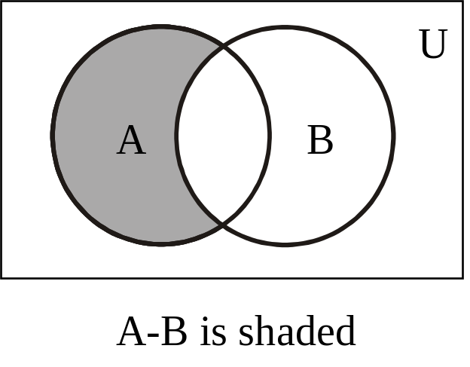
DIFFERENCE
VENN DIAGRAM FOR SET DIFFERENCE
REMARK:
  A – B ≠ B – A that is set difference is not commutative.
  A – B ⊆ A
  A – B, A ∩ B and B – A are mutually disjoint sets.

Slide 10
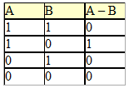
DIFFERENCE
MEMBERSHIP TABLE FOR SET DIFFERENCE
The membership table is similar to the truth table for ~ (p →q).

Slide 11
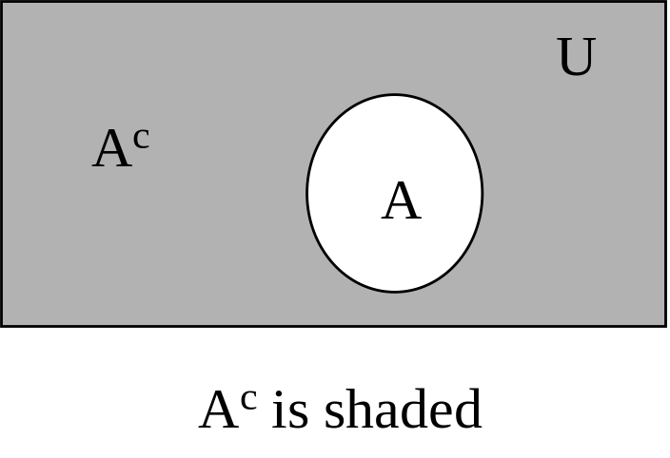
COMPLEMENT
Let A be a subset of universal set U. The complement of A is the set of all element in U that do not belong to A, and is denoted A^{c}
Symbolically:
  A^{c} = {x ∈U | x ∉A}
EXAMPLE
  Let U = {a, b, c, d, e, f, g]
  A = {a, c, e, g}
  Then A^{c} = {b, d, f}

Slide 12

COMPLEMENT
REMARK :
  A^{c} = U – A
  A ∩ A^{c} = φ
  A ∪ A^{c} = U
  The membership table is similar to the truth table for logical connective negation (~)

Slide 13
EXERCISE
Let U = {1, 2, 3, …, 10}, X = {1, 2, 3, 4, 5}
Y = {y | y = 2 x, x ∈X}, Z = {z | z² – 9z + 14 = 0} {2,7}
Enumerate
  (1)X ∩ Y (2) Y ∪ Z (3) X – Z
  (4)Y^{c} (5) X^{c} – Z^{c} (6) (X – Z)^{c}
Given the following universal set U and its two subsets P and Q, where
  U = {x | x ∈ Z, 0 ≤ x ≤ 10}
  P = {x | x is a prime number}
  Q = {x | x² < 70}
      Draw a Venn diagram for the above
      List the elements in P^{c} ∩ Q

Slide 14
EXERCISE
Prove the following using Venn Diagrams:
  A – (A – B) = A ∩ B
  (A ∩ B)^{c} = A^{c} ∪ B^{c}
  A – B = A ∩ B^{c}
  Where A = {1, 2}, B = {2, 3}, U= {1, 2, 3, 4}
Prove the following using Membership Table:
  A – (A – B) = A ∩ B
  (A ∩ B)^{c} = A^{c} ∪ B^{c}
  A – B = A ∩ B^{c}

Slide 15
SET IDENTITIES
Let A, B, C be subsets of a universal set U.
  1. Idempotent Laws
    a. A ∪ A = A b. A ∩ A = A
  2. Commutative Laws
    a. A ∪ B = B ∪ A b. A ∩ B = B ∩ A
  3. Associative Laws
    a. A ∪ (B ∪ C) = (A ∪ B) ∪ C
    b. A ∩ (B ∩ C) = (A ∩ B) ∩ C
  4. Distributive Laws
    a. A ∪ (B ∩ C) = (A ∪ B) ∩ (A ∪ B)
    b. A ∩ (B ∪ C) = (A ∩ B) ∪ (A ∩ C)
  5. Identity Laws
    a. A ∪ ∅ = A b. A ∩ ∅ = ∅
    c. A ∪ U = U d. A ∩ U = A

Slide 16
SET IDENTITIES
  6. Complement Laws
    a. A ∪ A^{c} = U b. A ∩ A^{c} = ∅
    c. U^{c} = ∅ d. ∅^{c} = U
  7. Double Complement Law
    (A^{c})^{c} = A
  8. DeMorgan’s Laws
    a. (A ∪ B)^{c} = A^{c} ∩ B^{c} b. (A ∩ B)^{c} = A^{c} ∪ B^{c}
  9. Alternative Representation for Set Difference
    A – B = A ∩ B^{c}
  10. Subset Laws
    a. A ∪ B ⊆ C iff A ⊆ C and B ⊆ C
    b. C ⊆ A ∩ B iff C ⊆ A and C ⊆ B

Slide 17
EXERCISE
Prove that
  A ⊆ A ∪ B
  A – B ⊆ A
  If A ⊆ B and B ⊆ C then A ⊆ C
  A ⊆ B if, and only if, B^{c} ⊆ A^{c}
  A – B = A ∩ B^{c}
  (A ∪ B)^{c} = Ac ∩ B^{c}
  A ∩ (B ∩ C) = (A ∩ B) ∩ C
  A ∪ (B ∩ C) = (A ∪ B) ∩ (A ∪ C)
  For any sets A and B if A ⊆ B then
    (a) A ∩ B = A (b) A ∪ B = B
  A ∪ B = B when A ⊆ B
  For all subsets A and B of a universal set U, prove that
    (A – B) ∪ (A ∩ B) = A

Slide 18
PROVING SET IDENTITIES BY MEMBERSHIP TABLE
Prove the following using Membership Table:
  A – (A – B) = A ∩ B
  (A ∩ B)^{c} = A^{c} ∪ B^{c}
  A – B = A ∩ B^{c}

Slide 19
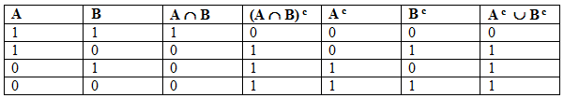
PROVING SET IDENTITIES BY MEMBERSHIP TABLE
(A ∩ B)^{c} = A^{c} ∪ B^{c}

